Slide 1
Elements Of Art
By: Natalie Hagen

Slide 2
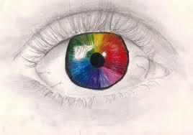
Color
http://williamlidigit.blogspot.com/
http://bxsciart2012.wordpress.com/category/elements-of-art/

Slide 3
Shape
http://kittistars222.wordpress.com/
http://www.ggdesignsembroidery.com/

Slide 4
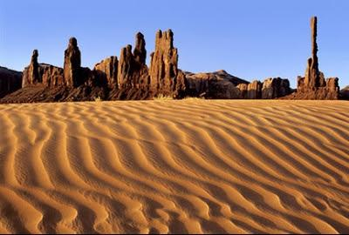
Line
http://www.forumaski.com/fotografcilik/15740-manzara-fotografi-cekmek-icin-4-altin-kural.html
http://www.bhsec1pta.org/wp-content/uploads/2013/04/

Slide 5
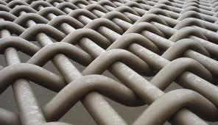
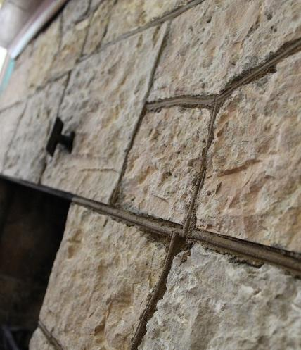
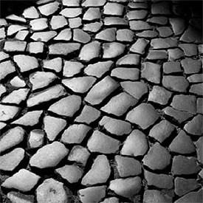
Texture
http://tutzone.org/11-cool-and-free-textures-for-your-next/
http://www.photoaxe.com/photography-tutorial-urban-patterns-in-photography/

Slide 6
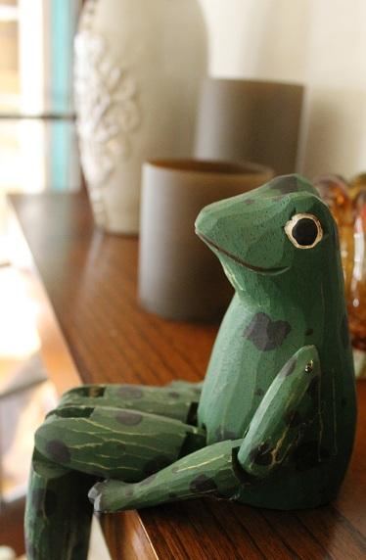
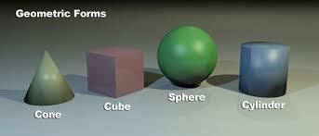
Form
http://thevirtualinstructor.com/form.html

Slide 7
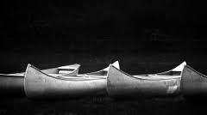
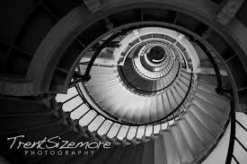
Tone
http://galleryhip.com/shape-element-of-art-photography.html
http://www.trentsizemore.com/elements-of-art/the-elements-of-art-in-photography-shape/

Slide 8
Space
http://nicolettesaner8.wikispaces.com/Elements+of+Art
http://sshumski.wikispaces.com/Elements+of+art

